Slide 2
COMPONENTS
IC 4017
LED x 6
Battery 9 volts
Breadboard
Wires

Slide 3
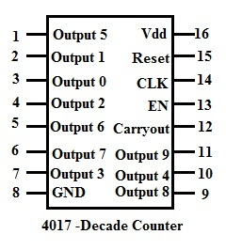
IC 4017
CD 4017 is used for low range counting applications
It has 10 outputs pins

Slide 4
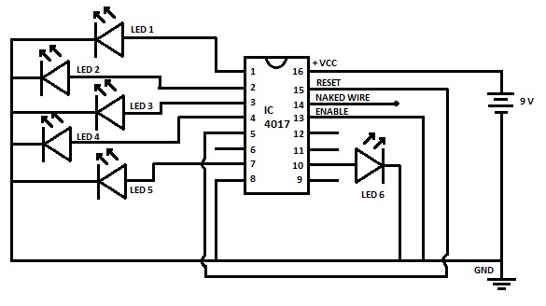
Circuit Diagram

Slide 5
 | Binary | Reset
0 | 0 0 0 | 0
1 | 0 0 1 | 0
2 | 0 1 0 | 0
3 | 0 1 1 | 0
4 | 1 0 0 | 0
5 | 1 0 1 | 0
6 | 1 1 0 | 1

Slide 6
Thank You...

